Slide 1
R4R.ONE
March 2022

Slide 2
RACE FOR RECONCILIATION
MANIFESTO:
Healing from the past.
Honor in the present.
Hope for the future.
Imagine a movement where people believe again, even dare to dream again.
Imagine people from all races uniting in goodwill and for the greater good.
Imagine ten’s of thousands of people coming together in each city to promote love and equality.
Imagine a Race for Reconciliation.
R4R.ONE

Slide 3
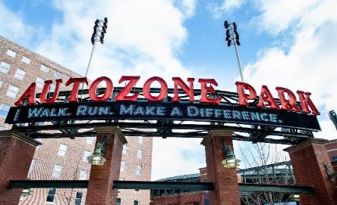
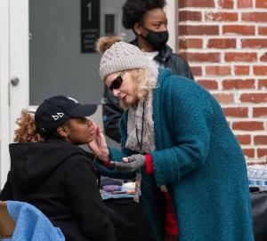
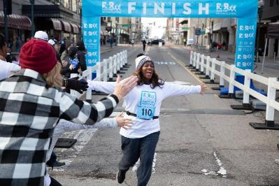
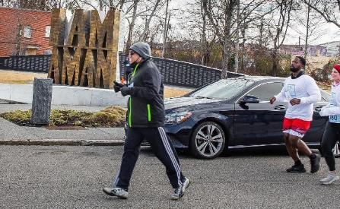
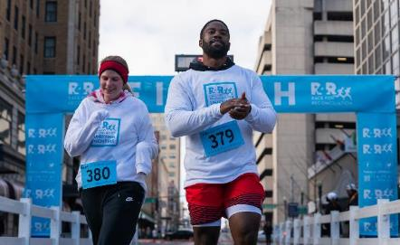
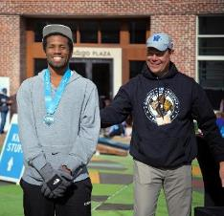
R4R.ONE

Slide 4
RACE FOR RECONCILIATION
VISION:
To be one of the most positive, unifying voices and movements on racial reconciliation in the world.
The races (5k’s, 1 mile and virtual) are entry-level opportunities for every person to participate and have their mind and heart moved to action.
Inspire people to prove love works.
Build a movement of unity.
Partner together to educate and elevate all people.
R4R.ONE

Slide 5
STRATEGIC GOALS
THE R4R PROGRAM:
Literacy Tutoring
Vocational Training
Leadership Development
FINANCE & GOVERNANCE:
Create city-specific executive teams that identify 3-4 local charities that will be resourced through race profits
Advance education platform through podcast, blogs, curriculum, live events and workshops
MARKETING & COMMUNICATIONS:
Develop R4R branding through creation of an apparel line, music and leveraging social media channels
Strategic Blueprint
R4R.ONE

Slide 6
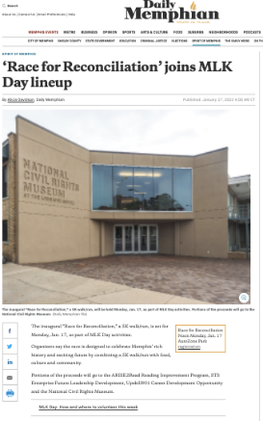
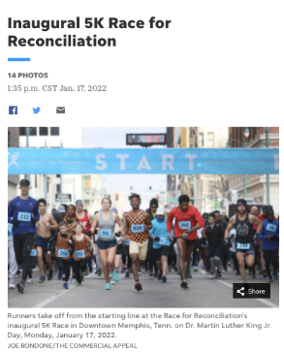
In our first year, we’re already getting the attention of the entire city!
Recognized as one of the top 5 ways to celebrate MLK Day in the Commercial Appeal
Multiple articles in the Commercial Appeal and The Daily Memphian
Featured on Marybeth Conley Show on channel 3
Featured on Geoff Calkins Show on ESPN radio
Over 100 University of Memphis student athletes volunteered
Over 40 citizens volunteered through Volunteer Memphis
R4R.ONE

Slide 7
What does success look like in year 2?
2500 race participants
200 scholarship attendees
Convert 10% of race participants to serve in local nonprofits
50 businesses with employee participation
50 churches, non-profit and educational organizations participating
50 sponsors
Raise $200,000 in sponsorship dollars
Give one-third of profit to our 2023 city partners
Strategic Blueprint
R4R.ONE

Slide 8
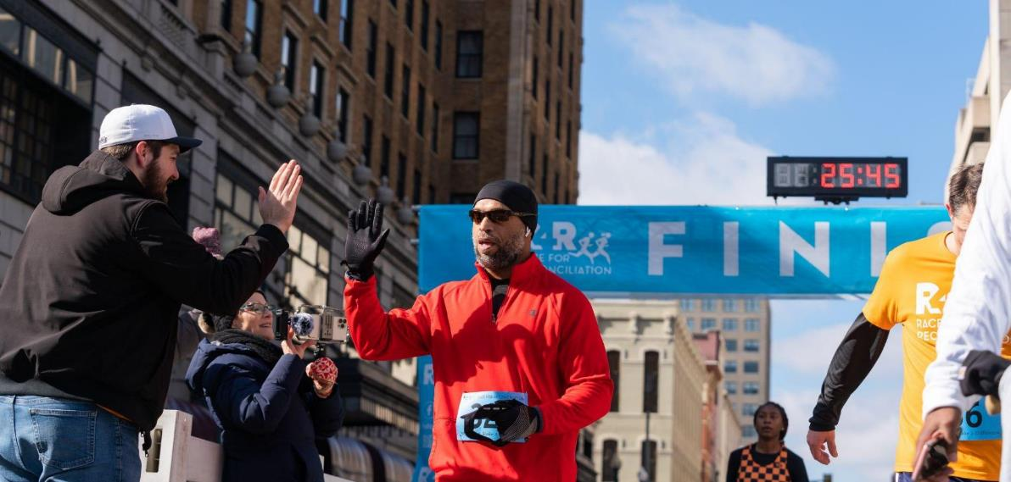
Ways You Can Make a Difference in Year 2
Leverage your influence to get participants and sponsorships
Become an Early Adopter
Purchase block of tickets for your organization to compete as a team or to give as scholarships to R4R city partners with need
Have your team utilize our communication kits
Represent R4R with branded gear and get the word out
R4R.ONE

Slide 9
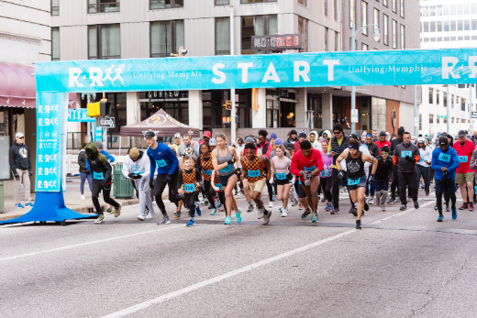
TITLE SPONSOR
R4R will provide to Title Sponsor:
Naming Rights to a Specific R4R Event
Expo Booth (largest size)
50 Complimentary Race Entries
VIP Access
IMAGE OR LOGO HERE
R4R.one

Slide 10
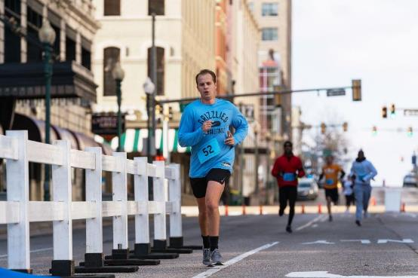
TITLE SPONSOR
R4R will include Title Sponsor logo on:
Link On Race for Reconciliation Website
R4R Event Guide
Start/Finish Line Signage
On-Course Signage
Event Shirts
Digital Assets
Event Specific Signage
IMAGE OR LOGO HERE
R4R.one

Slide 11
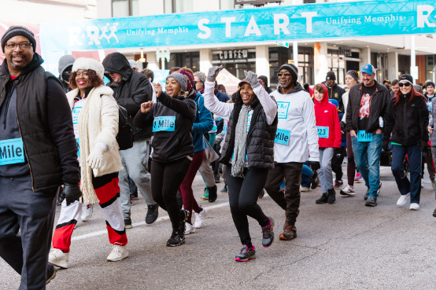
OFFICIAL SPONSOR
R4R will provide to Official Sponsor:
Naming Rights to a Specific R4R Event
Expo Booth (Medium)
25 Complimentary Race Entries
VIP Access
IMAGE OR LOGO HERE
R4R.one

Slide 12
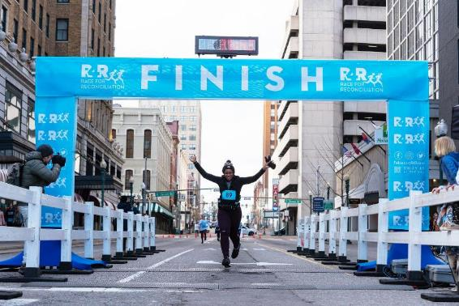
OFFICIAL SPONSOR
R4R will include Official Sponsor’s logo on:
Link on Race for Reconciliation Website
R4R Event Guide
Start/Finish Line Signage
On-Course Signage
Event Shirts
IMAGE OR LOGO HERE
R4R.one

Slide 13
OTHER SPONSORSHIP LEVELS
GOLD
SILVER
BRONZE
R4R.one

Slide 14
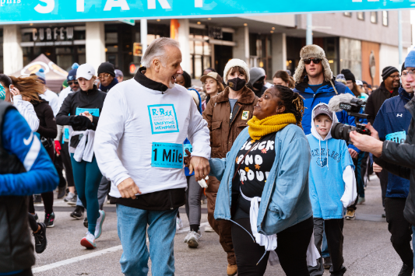
TICKET BLOCKS
Ticket Block Prices:
25 registrations for $950
50 registrations for $1900
100 registrations for $3800
150 registrations for $5250
IMAGE OR LOGO HERE
R4R.one
Notes:
Karin can put notes in here….

Slide 15
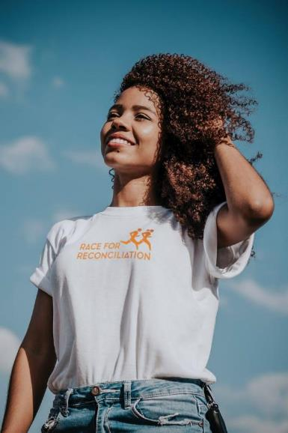
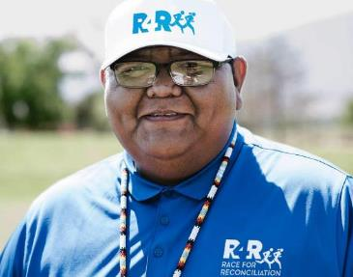
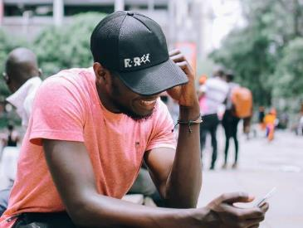
R4R.ONE

Slide 16
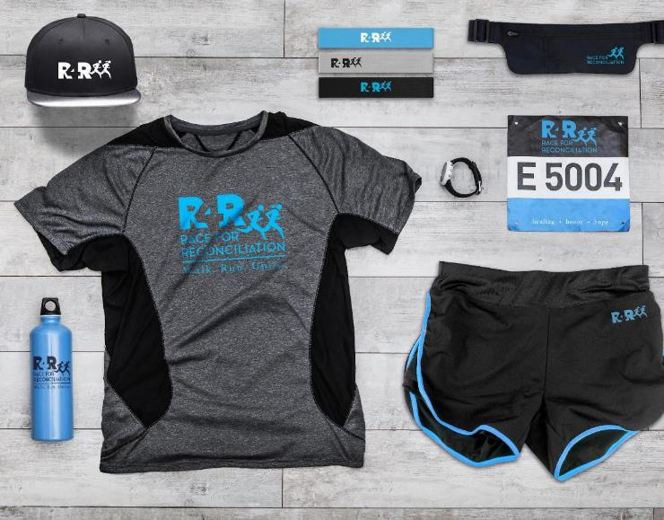
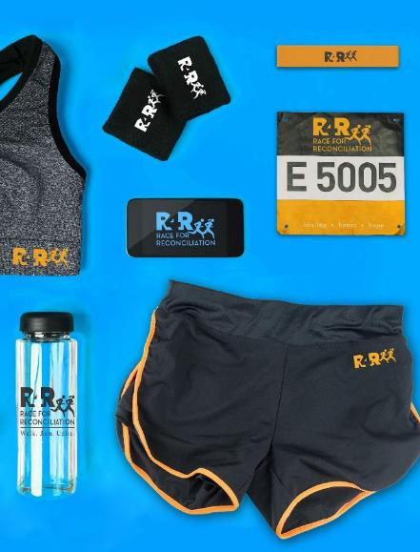
MEMPHIS 2021
MEMPHIS 2021
MEMPHIS 2021
R4R.ONE

Slide 17
MORE INFORMATION
Website: www.R4R.one
Set up personal or group info meeting: kconlee@R4R.one 901-550-0785
IMAR LOGO HERE
R4R.ONE

Slide 18
Thank You
R4R.ONE

Slide 19
R4R.ONE

